Slide 1

Introduction to NumPy and pandas
01/03/2024
Alexandre Oliveira
Fernanda Vieira

Slide 2
Outline
Matrices
What is a matrix?
Matrices operations
NumPy
Arrays
Basic operations
Indexing, slicing and iterating
Manipulation
pandas
Series
Dataframe
Dataframe manipulation
Viewing data
Indexing and selection
Missing data
Column operations
Daframe merge
Dataframe grouping
Plotting

Slide 3
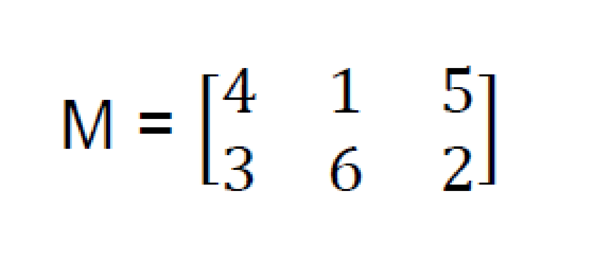
What is a matrix?
Numeric structures organized into rows (n) and columns (m)
They can be rectangular (n ≠ m) or square (n = m).
They can be used to represent linear systems.
(2 x 3)
Matrix of shape 2 per 3
element

Slide 4
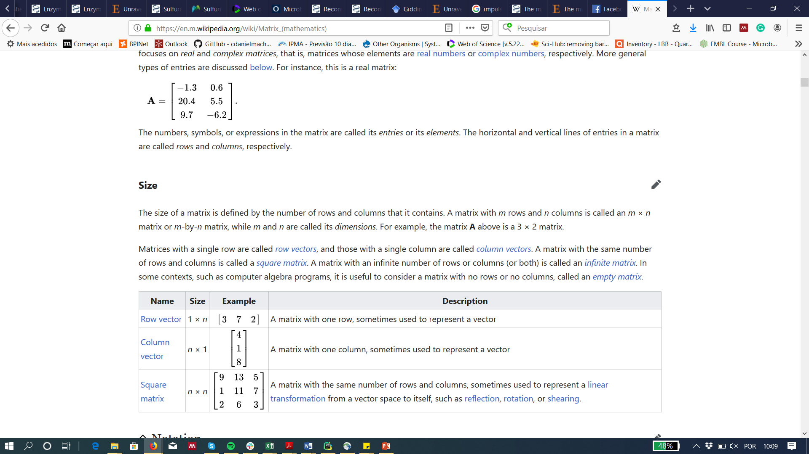
Type of matrices
Name | Shape | Example | Description
Row vector | 1 × m |  | A matrix with only one row
Column vector | n × 1 |  | A matrix with only one column
Square matrix | n × m |  | A matrix with the same number of rows and columns

Slide 5
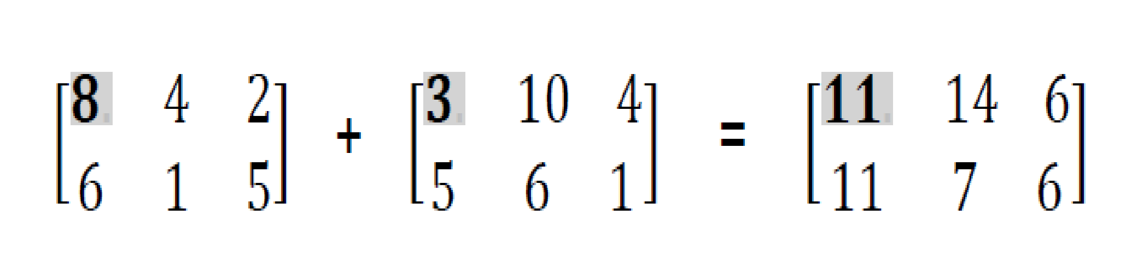
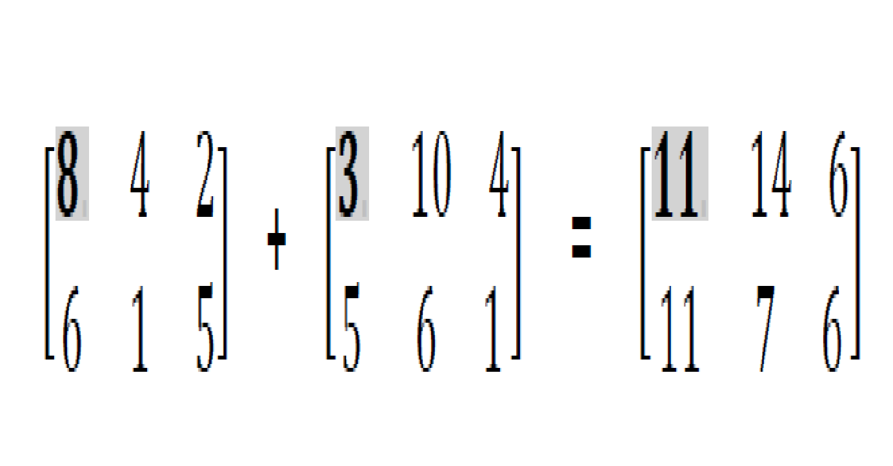
Matrices operations
Matrices additions and subtractions
Element-wise addition.

Slide 6
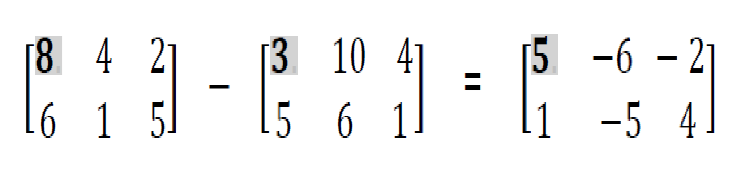
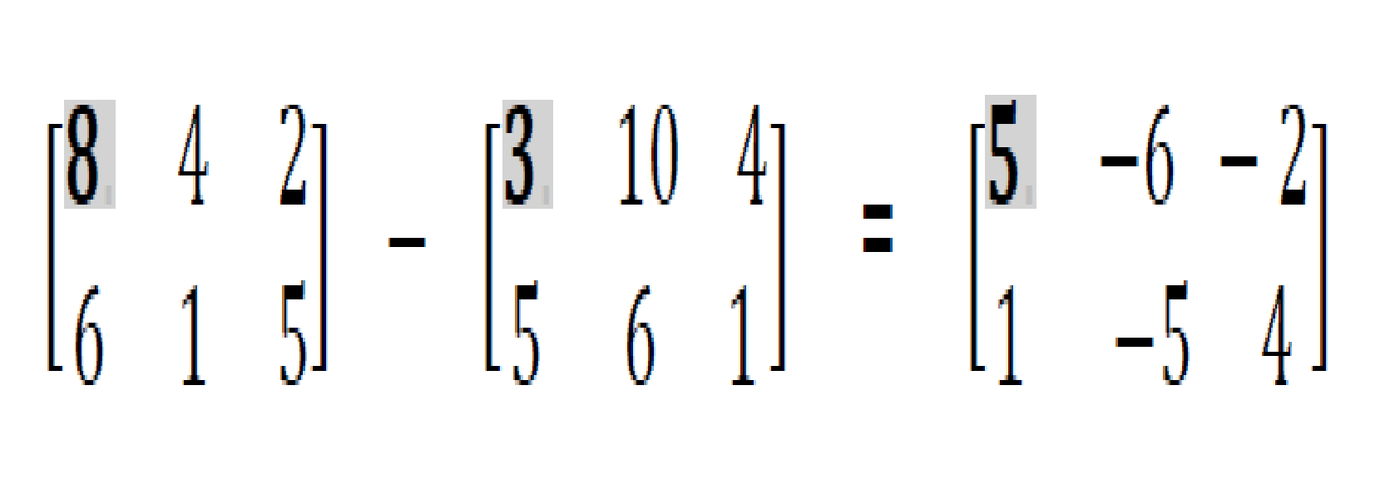
Matrices operations
Matrices additions and subtractions
Element-wise subtraction.
One can only add or subtract matrices of the same shape/size

Slide 7
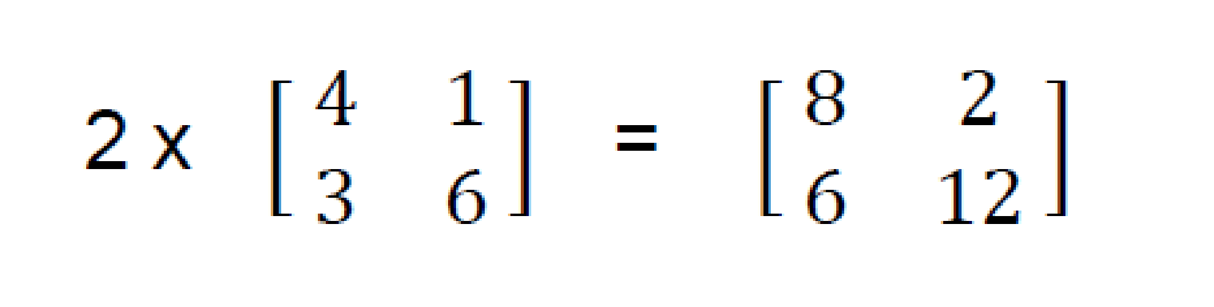
Operações com Matrizes
Multiplying by a number

Slide 8
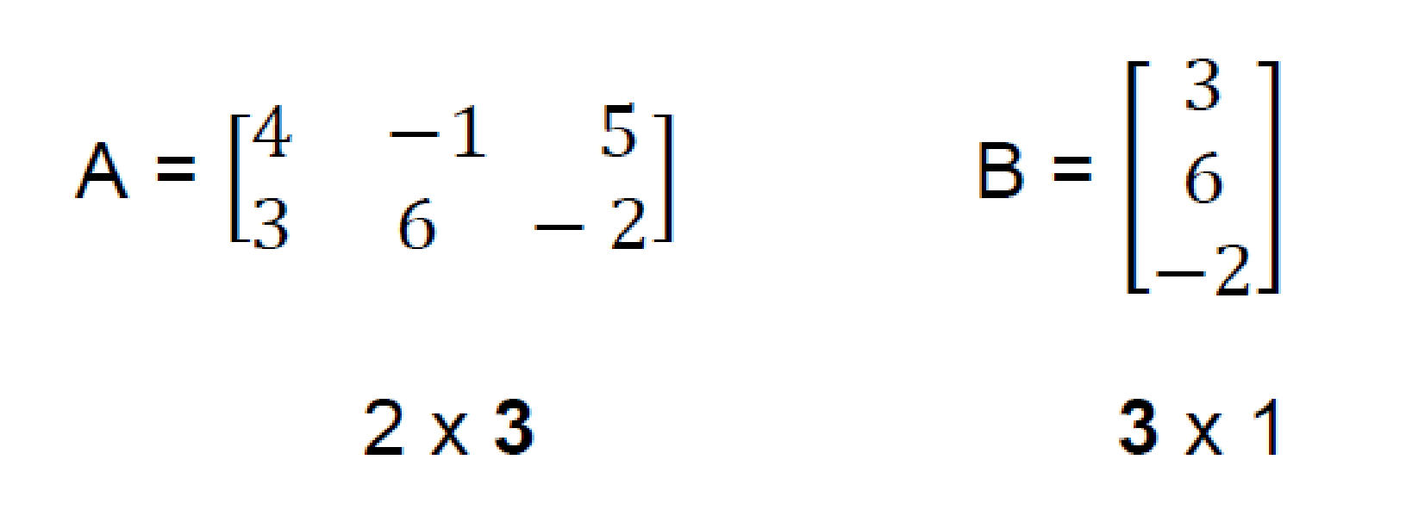
Matrices operations
Multiplying by another matrix
Multiplying two matrices can only be done if the number of columns (m) of the first matrix is the same as the number of rows (n) of the second

Slide 9
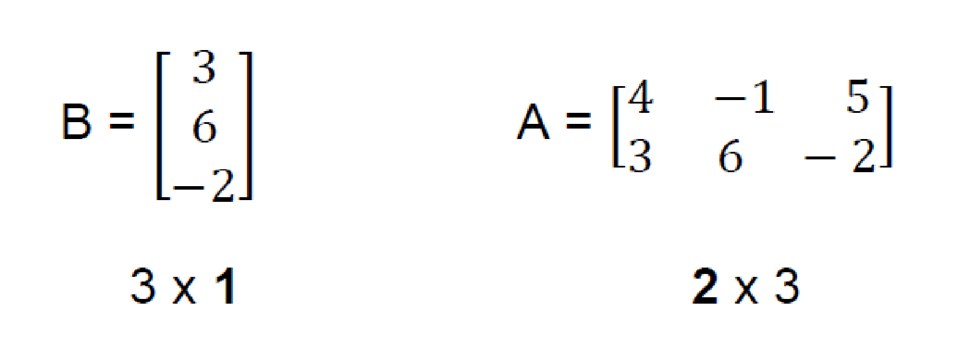
Matrices operations
Multiplying by another matrix
Matrices multiplication is not commutative!
(except for some square matrices)

Slide 10
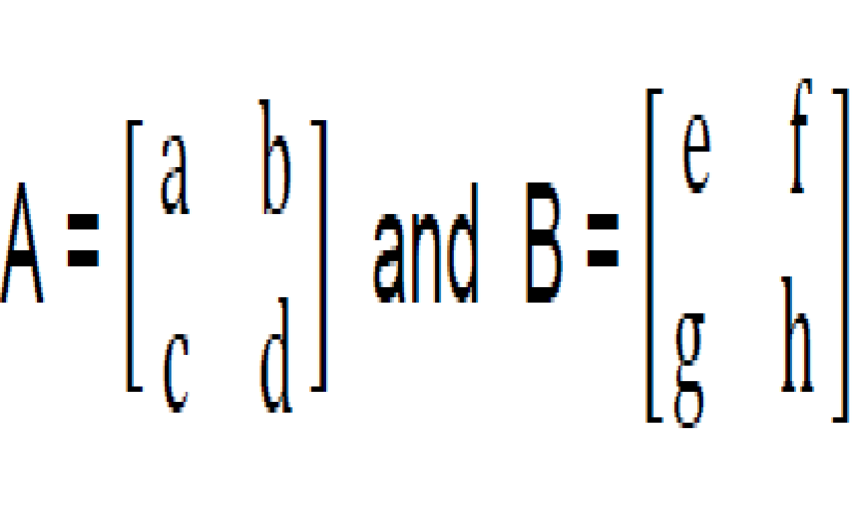
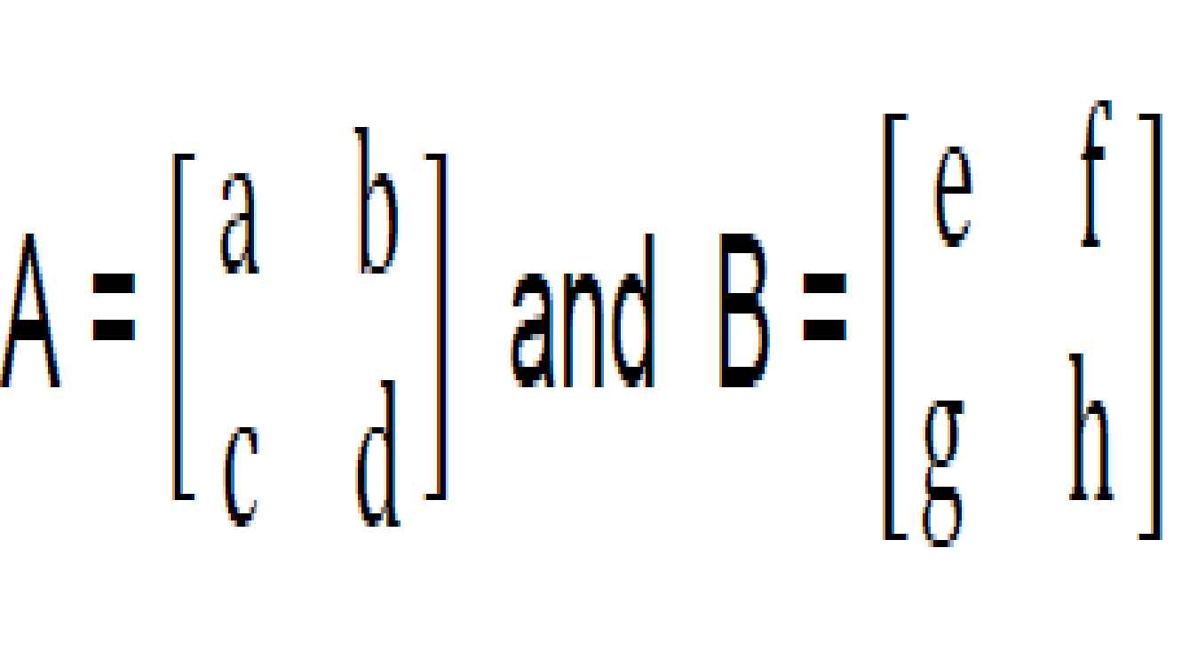
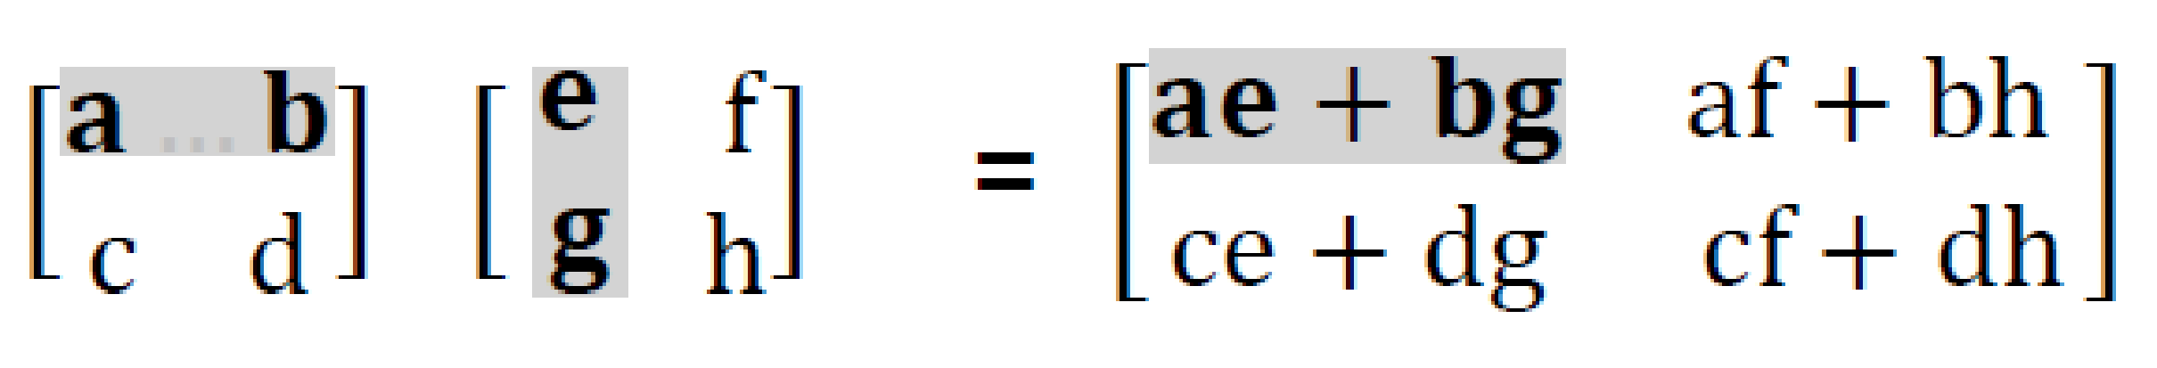
Matrices operations
Multiplying by another matrix
(2 x 2)
(2 x 2)
x
x
A x B =
(2 x 2)
x
x

Slide 11
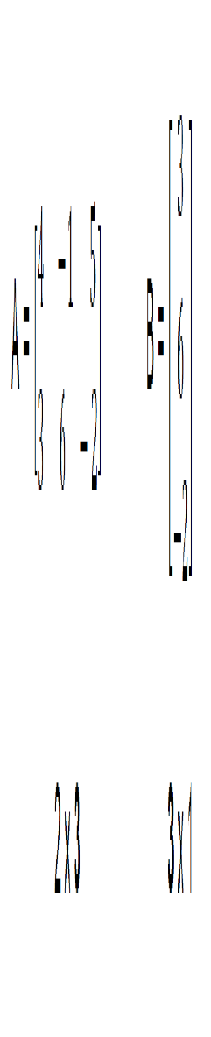
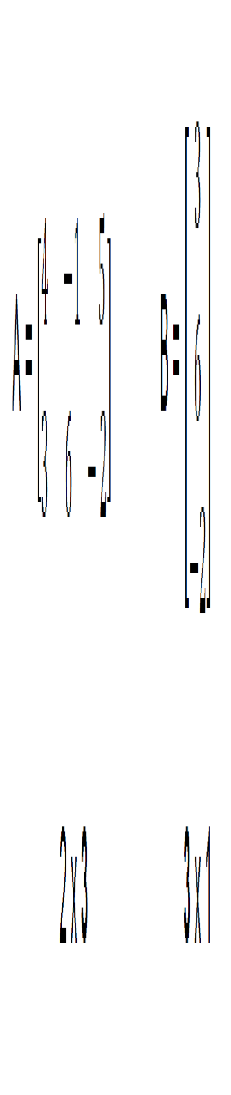
Matrices operations
Multiplying by another matrix
A x B =
4 x 3 + (-1) x 6 + 5 x (-2)
12 - 6 - 10
- 4
=
=
3 x 3 + 6 x 6 + (-2) x (-2)
9 + 36 + 4
49

Slide 12
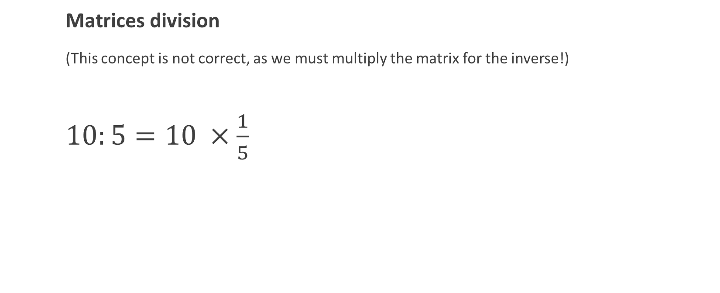
Matrices operations
A : B = A x B⁻¹

Slide 13
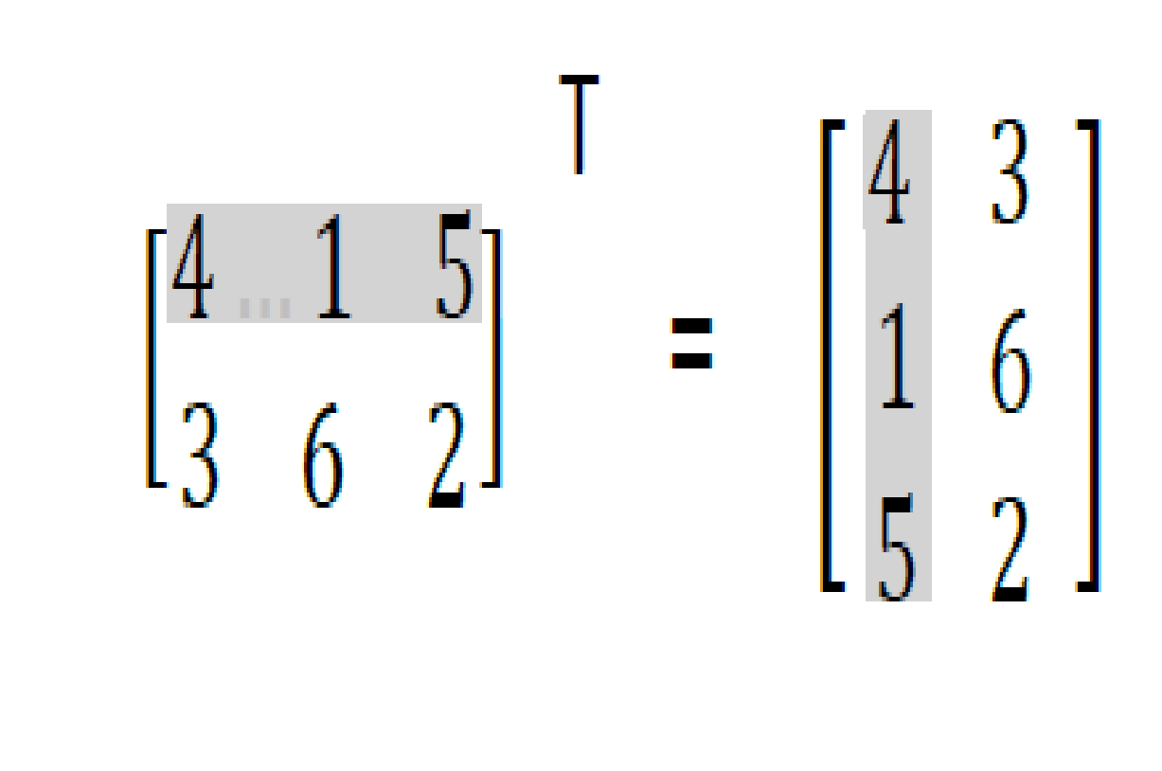
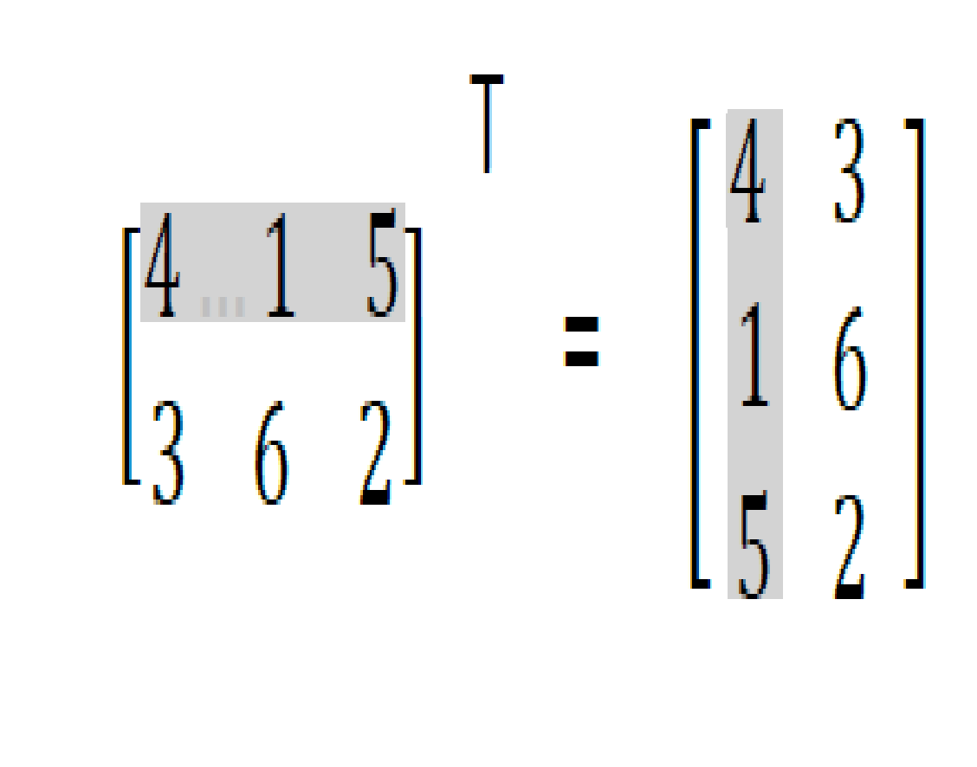
Matrices operations
Transpose
Transposing a matrix consists of switching rows by columns

Slide 14
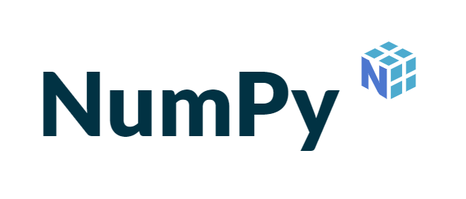

NumPy and pandas
Let’s implement this in Python
The fundamental package for scientific computing with Python
The fundamental package for data analysis and manipulation in Python

